Slide 1

Problem
Computer systems provide crucial services
Computer systems fail
  natural disasters
  hardware failures
  software errors
  malicious attacks
client
server
Need highly-available services

Slide 2
Replication
unreplicated service
replicated service
client
client
server
server
replicas
Replication algorithm:
masks a fraction of faulty replicas
high availability if replicas fail “independently”
software replication allows distributed replicas

Slide 3
Assumptions are a Problem
Replication algorithms make assumptions:
  behavior of faulty processes
  synchrony
  bound on number of faults
Service fails if assumptions are invalid
  attacker will work to invalidate assumptions
Most replication algorithms assume too much

Slide 4
Contributions
Practical replication algorithm:
  weak assumptions ≡ tolerates attacks
  good performance
Implementation
  BFT: a generic replication toolkit
  BFS: a replicated file system
Performance evaluation
BFS is only 3% slower than a standard file system

Slide 5
Talk Overview
Problem
Assumptions
Algorithm
Implementation
Performance
Conclusions

Slide 6
Bad Assumption: Benign Faults
Traditional replication assumes:
  replicas fail by stopping or omitting steps
Invalid with malicious attacks:
  compromised replica may behave arbitrarily
  single fault may compromise service
  decreased resiliency to malicious attacks
client
server
replicas
attacker replaces
replica’s code

Slide 7
BFT Tolerates Byzantine Faults
Byzantine fault tolerance:
  no assumptions about faulty behavior
Tolerates successful attacks
  service available when hacker controls replicas
client
server
replicas
attacker replaces
replica’s code

Slide 8
Byzantine-Faulty Clients
Bad assumption: client faults are benign
  clients easier to compromise than replicas
BFT tolerates Byzantine-faulty clients:
  access control
  narrow interfaces
  enforce invariants
attacker replaces
client’s code
server
replicas
Support for complex service operations is important

Slide 9
Bad Assumption: Synchrony
Synchrony ≡ known bounds on:
  delays between steps
  message delays
Invalid with denial-of-service attacks:
  bad replies due to increased delays
Assumed by most Byzantine fault tolerance

Slide 10
Asynchrony
No bounds on delays
Problem: replication is impossible
Solution in BFT:
provide safety without synchrony
  guarantees no bad replies
assume eventual time bounds for liveness
  may not reply with active denial-of-service attack
  will reply when denial-of-service attack ends

Slide 11
Talk Overview
Problem
Assumptions
Algorithm
Implementation
Performance
Conclusions

Slide 12
Algorithm Properties
clients
Arbitrary replicated service
  complex operations
  mutable shared state
Properties (safety and liveness):
  system behaves as correct centralized service
  clients eventually receive replies to requests
Assumptions:
  3f+1 replicas to tolerate f Byzantine faults (optimal)
  strong cryptography
  only for liveness: eventual time bounds
replicas

Slide 13
Algorithm Overview
State machine replication:
  deterministic replicas start in same state
  replicas execute same requests in same order
  correct replicas produce identical replies
f+1 matching
replies
client
replicas
Hard: ensure requests execute in same order

Slide 14
Ordering Requests
Primary-Backup:
View designates the primary replica
Primary picks ordering
Backups ensure primary behaves correctly
  certify correct ordering
  trigger view changes to replace faulty primary
client
replicas
primary
backups
view

Slide 15
Quorums and Certificates
quorums have at least 2f+1 replicas
quorum A
quorum B
3f+1 replicas
quorums intersect in at least one correct replica
Certificate ≡ set with messages from a quorum
Algorithm steps are justified by certificates

Slide 16
Algorithm Components
Normal case operation
View changes
Garbage collection
Recovery
All have to be designed to work together

Slide 17
Normal Case Operation
Three phase algorithm:
  pre-prepare picks order of requests
  prepare ensures order within views
  commit ensures order across views
Replicas remember messages in log
Messages are authenticated
  ⟨•⟩ denotes a message sent by k
σk
Notes:
Need to introduce certificates since that notion will be usefull later

Slide 18
Pre-prepare Phase
assign sequence number n to request m in view v
request : m
multicast ⟨PRE-PREPARE,v,n,m⟩
σ0
primary = replica 0
replica 1
replica 2
fail
replica 3
backups accept pre-prepare if:
  in view v
  never accepted pre-prepare for v,n with different request

Slide 19
Prepare Phase
digest of m
multicast ⟨PREPARE,v,n,D(m),1⟩
σ1
m
prepare
pre-prepare
replica 0
replica 1
replica 2
replica 3
fail
accepted ⟨PRE-PREPARE,v,n,m⟩
σ0
all collect pre-prepare and 2f matching prepares
P-certificate(m,v,n)

Slide 20
Order Within View
No P-certificates with the same view and sequence number and different requests
If it were false:
replicas
quorum for
P-certificate(m,v,n)
quorum for
P-certificate(m’,v,n)
one correct replica in common ⇒ m = m’

Slide 21
Commit Phase
multicast ⟨COMMIT,v,n,D(m),2⟩
σ2
replies
m
pre-prepare
prepare
commit
replica 0
replica 1
replica 2
replica 3
fail
replica has
P-certificate(m,v,n)
all collect 2f+1 matching commits
C-certificate(m,v,n)
Request m executed after:
having C-certificate(m,v,n)
executing requests with sequence number less than n

Slide 22
View Changes
Provide liveness when primary fails:
  timeouts trigger view changes
  select new primary (≡ view number mod 3f+1)
But also need to:
  preserve safety
  ensure replicas are in the same view long enough
  prevent denial-of-service attacks

Slide 23
View Change Safety
Goal: No C-certificates with the same sequence number and different requests
Intuition: if replica has C-certificate(m,v,n) then
quorum for
C-certificate(m,v,n)
any quorum Q
correct replica in Q has P-certificate(m,v,n)

Slide 24
View Change Protocol
send P-certificates: ⟨VIEW-CHANGE,v+1,P,2⟩
σ2
replica 0 = primary v
fail
replica 1= primary v+1
replica 2
replica 3
primary collects
X-certificate: ⟨NEW-VIEW,v+1,X,O⟩
σ1
pre-prepares matching
P-certificates with highest views in X
pre-prepare for m,v+1,n in new-view
Backups multicast prepare
messages for m,v+1,n
backups multicast prepare messages for pre-prepares in O

Slide 25
Garbage Collection
Truncate log with certificate:
periodically checkpoint state (K)
multicast ⟨CHECKPOINT,h,D(checkpoint),i⟩
all collect 2f+1 checkpoint messages
send S-certificate and checkpoint in view-changes
σi
S-certificate(h,checkpoint)
discard messages and checkpoints
Log
sequence
numbers
h
H=h+2K
reject messages

Slide 26
Formal Correctness Proofs
Complete safety proof with I/O automata
  invariants
  simulation relations
Partial liveness proof with timed I/O automata
  invariants

Slide 27
Communication Optimizations
Digest replies: send only one reply to client with result
Optimistic execution: execute prepared requests
Read-only operations: executed in current state
client
Read-write operations execute in two round-trips
client
Read-only operations execute in one round-trip

Slide 28
Talk Overview
Problem
Assumptions
Algorithm
Implementation
Performance
Conclusions

Slide 29
BFT: Interface
Generic replication library with simple interface
Client:
int Byz_init_client(char* conf);
int Byz_invoke(Byz_req* req, Byz_rep* rep, bool read_only);
Server:
int Byz_init_replica(char* conf, Upcall exec, char* mem, int sz);
Upcall: int execute(Byz_req* req, Byz_rep* rep, int client_id, bool read_only);
void Byz_modify(char* mod, int sz);

Slide 30
BFS: A Byzantine-Fault-Tolerant NFS
replica 0
snfsd
replication
library
replication
library
andrew
benchmark
kernel VM
relay
snfsd
kernel NFS client
replication
library
kernel VM
replica n
No synchronous writes – stability through replication

Slide 31
Talk Overview
Problem
Assumptions
Algorithm
Implementation
Performance
Conclusions

Slide 32
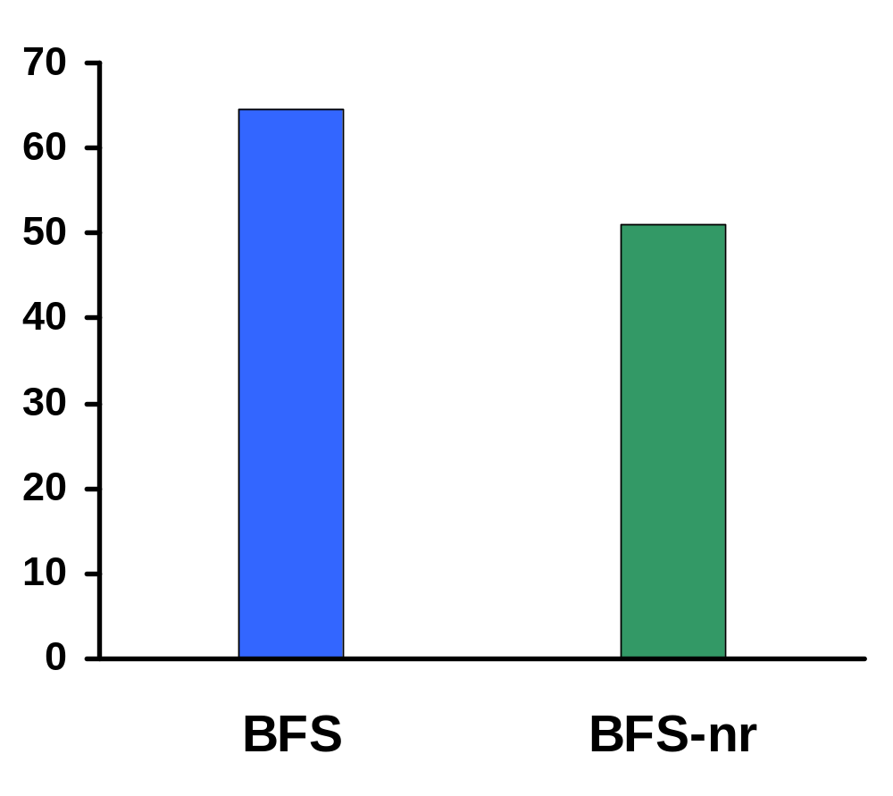
Andrew Benchmark
Configuration
1 client, 4 replicas
Alpha 21064, 133 MHz
Ethernet 10 Mbit/s
Elapsed time (seconds)
BFS-nr is exactly like BFS but without replication
30 times worse with digital signatures

Slide 33
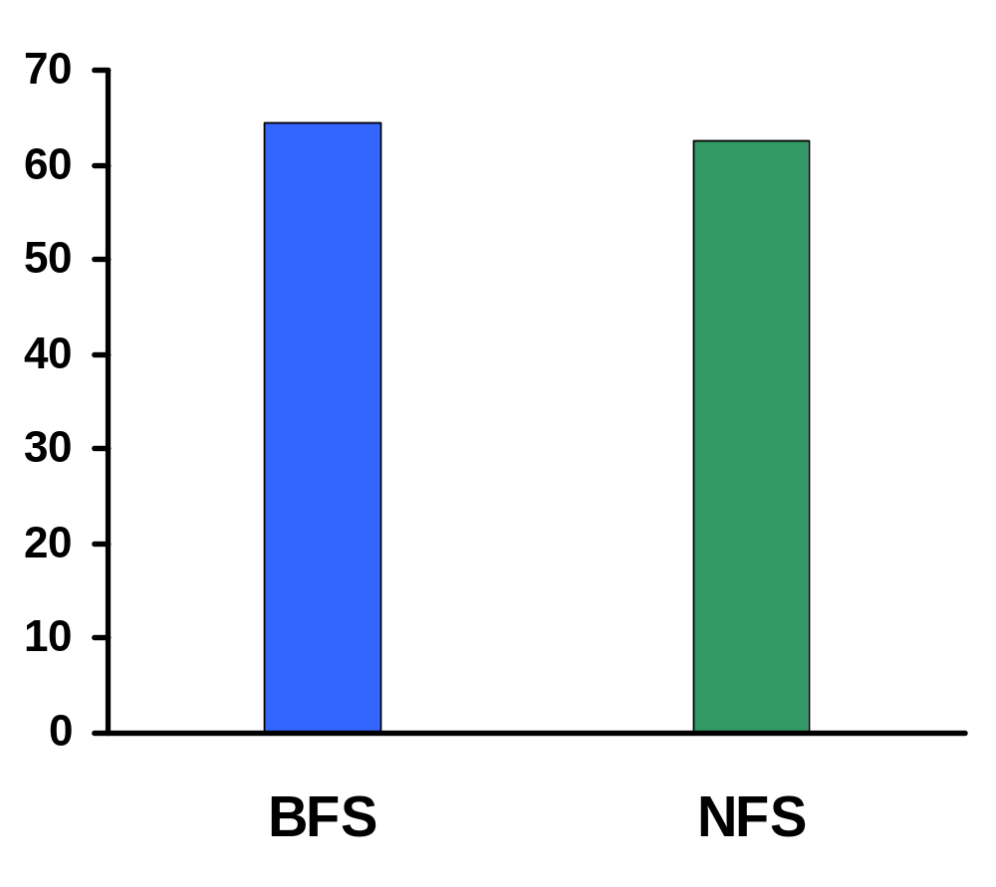
BFS is Practical
Configuration
1 client, 4 replicas
Alpha 21064, 133 MHz
Ethernet 10 Mbit/s
Andrew benchmark
Elapsed time (seconds)
NFS is the Digital Unix NFS V2 implementation

Slide 34
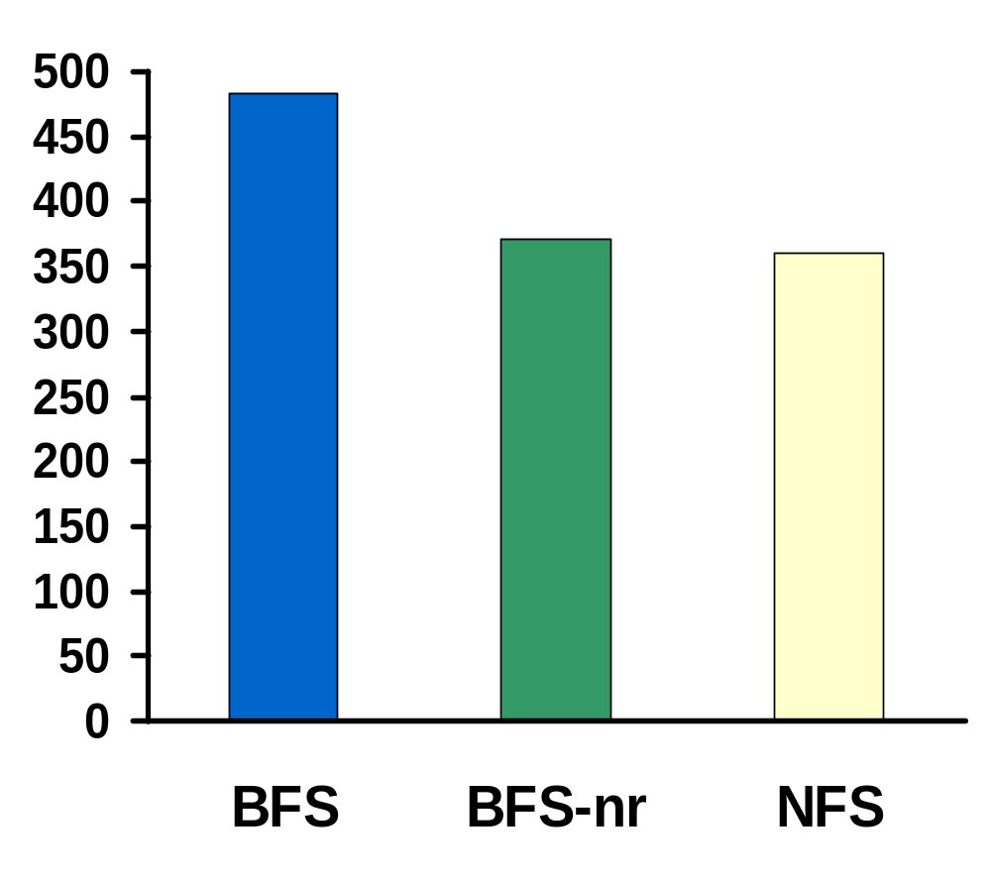
BFS is Practical 7 Years Later
Configuration
1 client, 4 replicas
Pentium III, 600MHz
Ethernet 100 Mbit/s
100x Andrew benchmark
Elapsed time (seconds)
NFS is the Linux 2.2.12 NFS V2 implementation

Slide 35
Conclusions
Byzantine fault tolerance is practical:
  Good performance
  Weak assumptions ≡ improved resiliency

Slide 36
BASE: Using Abstraction to Improve Fault Tolerance
Rodrigo Rodrigues, Miguel Castro, and Barbara Liskov
MIT Laboratory for Computer Science and Microsoft Research
http://www.pmg.lcs.mit.edu/bft

Slide 37
BFT Limitations
Replicas must behave deterministically
Must agree on virtual memory state
Therefore:
  Hard to reuse existing code
  Impossible to run different code at each replica
  Does not tolerate deterministic SW errors

Slide 38
Talk Overview
Introduction
BASE Replication Technique
Example: File System (BASEFS)
Evaluation
Conclusion

Slide 39
BASE
(BFT with Abstract Specification Encapsulation)
Methodology + library
Practical reuse of existing implementations
  Inexpensive to use Byzantine fault tolerance
  Existing implementation treated as black box
  No modifications required
  Replicas can run non-deterministic code
Replicas can run distinct implementations
  Exploited by N-version programming
  BASE provides efficient repair mechanism
  BASE avoids high cost and time delays of NVP

Slide 40
Opportunistic N-Version Programming
Run different off-the-shelf implementations
Low cost with good implementation quality
More independent implementations:
  Independent development process
  Similar, not identical specifications
More than 4 implementations of important services
  Example: file systems, databases

Slide 41
Methodology
abstract
state
common abstract
specification
state conversion
functions
conformance
wrappers
state 1
state 2
state 3
state 4
existing service
implementations
code 1
code 2
code 3
code 4

Slide 42
Talk Overview
Introduction
BASE Replication Technique
Example: File System (BASEFS)
Evaluation
Conclusion

Slide 43
Abstract Specification
Defines abstract behavior + abstract state
BASEFS – abstract behavior:
  Based on NFS RFC
  Non-determinism problems in NFS:
    File handle assignment
    Timestamp assignment
    Order of directory entries

Slide 44
Exploiting Interoperability Standards
Abstract specification based on standard
Conformance wrappers and state conversions:
  Use standard interface specification
  Are equal for all implementations
  Are simpler
  Enable reuse of client code

Slide 45
Abstract State
Abstract state is transferred between replicas
Not a mathematical definition → must allow efficient state transfer
  Array of objects (minimum unit of transfer)
  Object size may vary
Efficient abstract state transfer and checking
  Transfers only corrupt or out-of-date objects
  Tree of digests
meta-data
abstract objs

Slide 46
BASEFS: Abstract State
One abstract object per file system entry
  Type
  Attributes
  Contents
Object identifier = index in the array
concrete NFS
server state:
Abstract state:
root
type
DIR
FILE
DIR
FILE
FREE
attributes
attr 0
attr 1
attr 2
attr 3
f1
d1
contents
<f1,1>
<d1,2>
<f2,3>
f2
0
1
2
3
4

Slide 47
Conformance Wrapper
Veneer that invokes original implementation
Implements abstract specification
Additional state – conformance representation
  Translates concrete to abstract behavior
concrete NFS
server state:
Conformance representation:
root
type
DIR
FILE
DIR
FILE
FREE
f1
d1
NFS file handle
fh 0
fh 1
fh 2
fh 3
timestamps
f2
0
1
2
3
4

Slide 48
BASEFS: Conformance Wrapper
Incoming Requests:
  Translates file handles
  Sends requests to NFS server
Outgoing Replies:
  Updates Conformance Representation
  Translates file handles and timestamps + sorts directories
  Return modified reply to the client

Slide 49
State Conversions
Abstraction function
  Concrete state → Abstract state
  Supplies BASE abstract objects
Inverse abstraction function
  Invoked by BASE to repair concrete state
Perform conversions at object granularity
Simple interface:
int get_obj(int index, char** obj);
void put_objs(int nobjs, char** objs,
int* indices, int* sizes);

Slide 50
BASEFS: Abstraction Function
1. Obtains file handle from conformance representation
2. Invokes NFS server to obtain object’s data and meta-data
3. Replaces timestamps
4. Directories → sort entries and convert file handles to oids
type
FILE
Abstract object. Index = 3 →
attributes
attrs
Concrete NFS
server state:
contents
root
Conformance representation:
type
DIR
FILE
DIR
FILE
FREE
f1
d1
NFS file handle
fh 0
fh 1
fh 2
fh 3
timestamps
f2
0
1
2
3
4

Slide 51
Talk Overview
Introduction
BASE Replication Technique
Example: File System (BASEFS)
Evaluation
Conclusion

Slide 52
Evaluation
Code complexity
  Simple code is unlikely to introduce bugs
  Simple code costs less to write
Overhead of wrapping and state conversions

Slide 53
Code Complexity
Measured number of “;”
Linux NFS + FS + SCSI driver has 17735 “;”
client relay | 63
conformance wrapper | 561
state conversions | 481
total | 1105

Slide 54
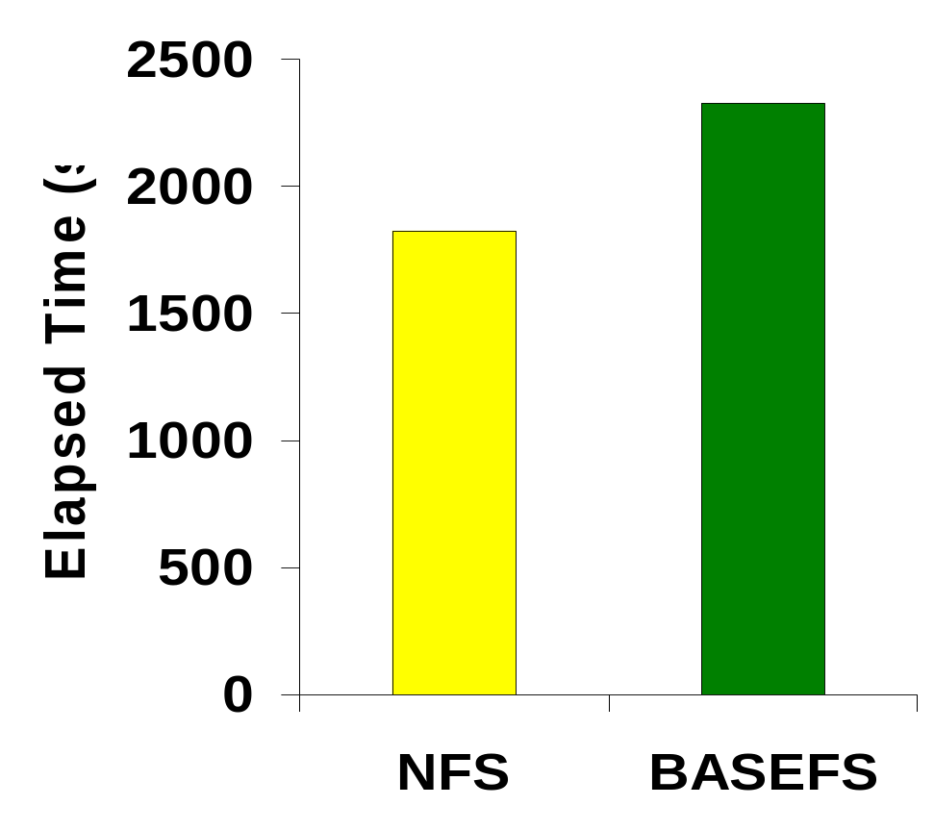
Overhead: Andrew500 (1GB)
1 client, 4 replicas
Linux 2.2.16
Pentium III 600MHz
512MB RAM
Fast Ethernet
NFS is the NFS implementation in Linux
BASEFS is replicated – homogeneous setup
BASEFS is 28% slower than NFS

Slide 55
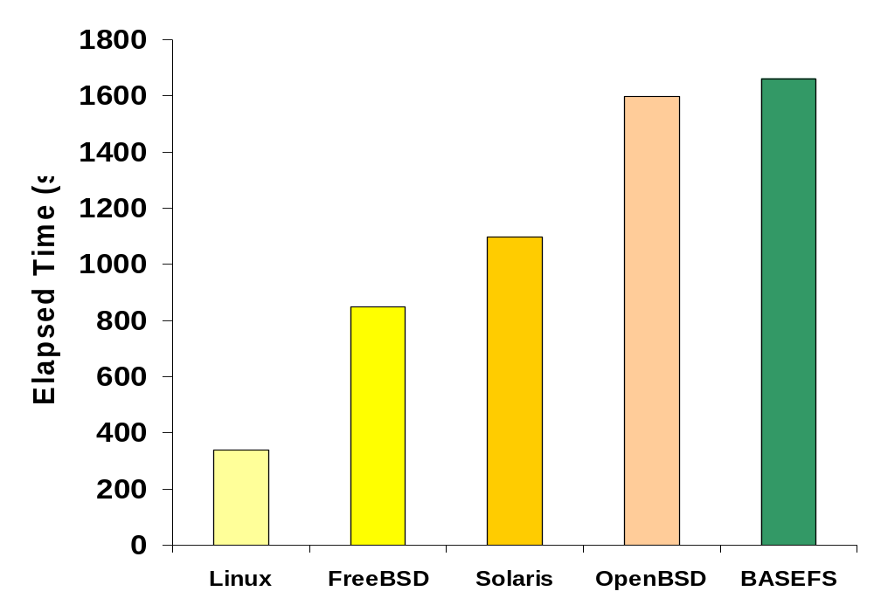
Overhead: heterogeneous setup
Andrew 100
4% slower than slowest replica

Slide 56
Conclusions
Abstraction + Byzantine fault tolerance
  Reuse of existing code
  Opportunistic N-version programming
  SW rejuvenation through proactive recovery
Works well on simple (but relevant) example
  Simple wrapper and conversion functions
  Low overhead
Another example: object-oriented database
Future work:
  Better example: relational databases with ODBC

